Slide 1
A Privacy-Preserving Data Valuation Visualization System

Slide 2
Contents
Introduction
Literature Review
System Design
Demo

Slide 3
Introduction
Background
Purpose of Research
Scope

Slide 4
Background
Increased regulation of data
Hard to conduct collaborative machine learning
Proposed federated learning
Lack of visualisation system for stakeholders

Slide 5
Purpose of research
To develop a visualisation system for stakeholder
Easy to use
Easy to understand
Minimal technical knowledge required

Slide 6
Scope
Develop a visualisation system using Python
Displays relevant detail to the stakeholders
No anomaly detection
Shows obvious anomaly

Slide 7
Literature Review
Shapley Value
Using Shapley Value in Federated Learning
Shapley Value Estimation
Estimation Techniques

Slide 8
Literature Review
Visualisation System
Research Gap

Slide 9
Shapley value
From Game Theory
Expects uneven contribution from multiple players
Fair distribution of reward

Slide 10
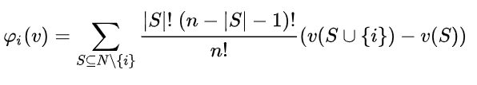
Shapley Value

Slide 11
Using Shapley Value in Federated Learning
To evaluate participant contribution
Multiple participants, uneven contribution
Evaluates based on performance gain
No access to data set

Slide 12
Using Shapley Value in Federated Learning
Train model multiple times
Time complexity is O(2^n)
Costly
Expected 10-20 participants with huge dataset

Slide 13
Estimation of Shapley Value
Trade little accuracy loss
Reduced large amount of resources required
Time complexity reduces from exponential to polynomial

Slide 14
Estimation Techniques - Gradient Shapley
Train model 1 time
Record gradient
Build model for evaluation using gradients
One Round Reconstruction
Multi-Round Reconstruction

Slide 15
Estimation Techniques - Truncated Monte-Carlo
Samples participant randomly
Truncates training when marginal gain is below threshold
Set contribution to 0

Slide 16
Estimation Techniques - Guided Truncation Gradient Shapley (GTG – Shapley)
Records gradient and reconstruct models for evaluation
Fixed permutation of first few positions
Between round truncation
Within round truncation

Slide 17
Visualisation system
Federated learning produces large amount of date
Able to take in the large output
Displays relevant data to stakeholders
Allows filtering of results
Display obvious anomaly

Slide 18
Research gap
Not suited to take in data from federated learning
Large number of participants

Slide 19
System Design
Application Description
User Needs
System Architecture

Slide 20
Application Description
Take in output from GTG – Shapley
Displays relevant data to the stakeholders
Displays an overview
Allow users to choose and filter

Slide 21
User needs - Participants
View contribution and model performance
Compare results with other participants

Slide 22
User needs - Federated Learning Initiators
View participant reputation
Invite participants for federated learning
View participant contribution
View model details

Slide 23
User needs - federation owners
View all models
Manage participant reputation
Manage participant recommendation

Slide 24
System Architecture
Layered Architecture
Database Layer, Data Access Layer, Logic Layer and User Interface Layer

Slide 25
System Architecture - Database Layer Database
Database
Represented by a pickle file

Slide 26
System Architecture - Logic Layer
Controllers
Data processing
Pass data to User Interface Layer

Slide 27
System Architecture - User Interface Layer
Views
Displays data
Respond to user interactions

Slide 28
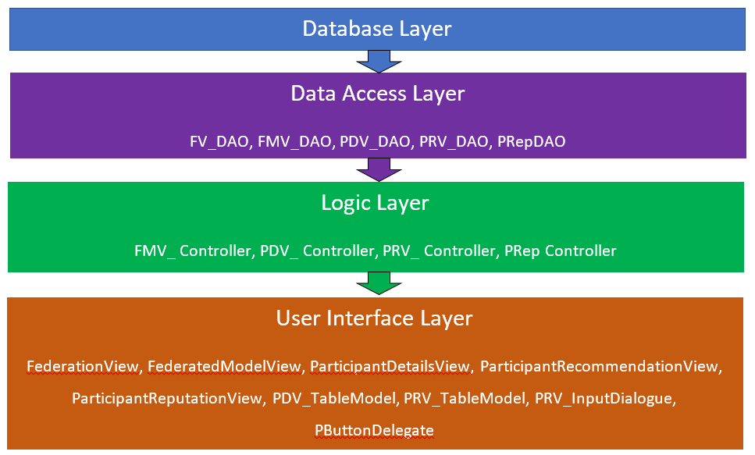
System Architecture

Slide 29
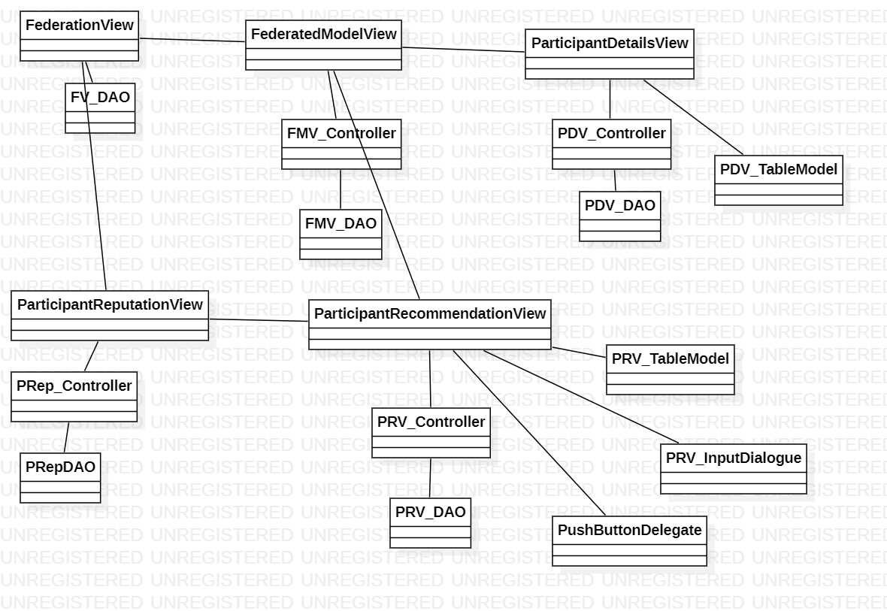
System Architecture

Slide 30
Demo

Slide 31
Q & A

Slide 32
Thank You

